Slide 1
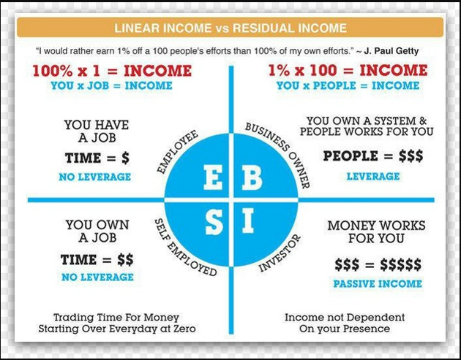

Slide 2
Customer
SHOP.com
/yourname
Unfranchise Business Owner
Cashback earned on purchases made (average 5%) at 2500 partner stores
Wholesale to Retail profit on exclusive MA brands (average 30%)
Business Volume (BV) commissions up to $2100/week
Internet Business Volume (IBV) commissions up to $1500/week
Earn $3600 a week
Cashback earned on purchases made (average 5%)
Recycle your household dollars
Convert Spending into Earning & Create Shopping Annuity
Earning $3600 a week or $187,000 a year

Slide 3
You can make a little money or make a lot of money doing what you are already doing ANYWAY!
Become a UnFranchise Business Owner.
Become your own best customer
Create a handful of customers

