Slide 2
Delivering Wellness for
Your Patients and Practice

Slide 3
nutraMetrix® Provides:
A complete suite of customized, cutting-edge solutions, exclusively for health professionals.
A wide variety of products and services designed to better serve patients and generate ancillary income for the practice.
Relevant information for an ever-changing healthcare industry.

Slide 4
A Changing Paradigm
Health Professionals report several factors are contributing to new economic challenges.
Rising business and drug costs
Shrinking insurance reimbursements
Changing regulations and reform initiatives
The economic challenges faced by Health Professionals are now reported in mainstream media (Wall Street Journal, Money Magazine, CNN, etc.).

Slide 5
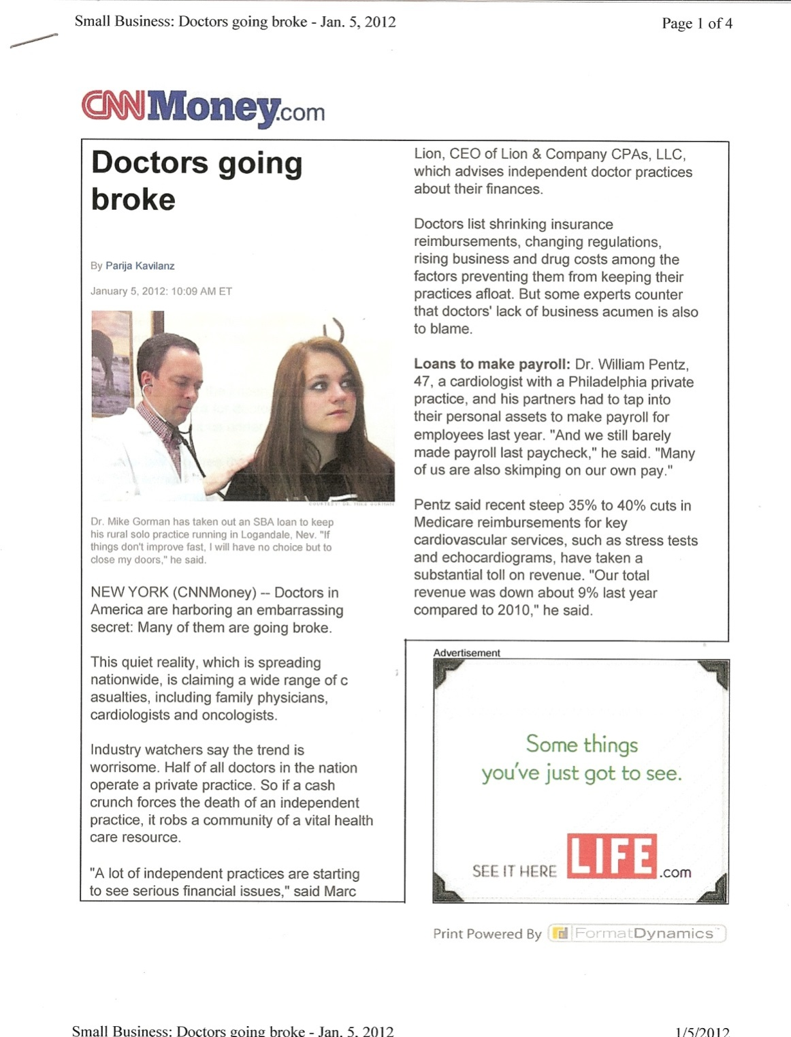
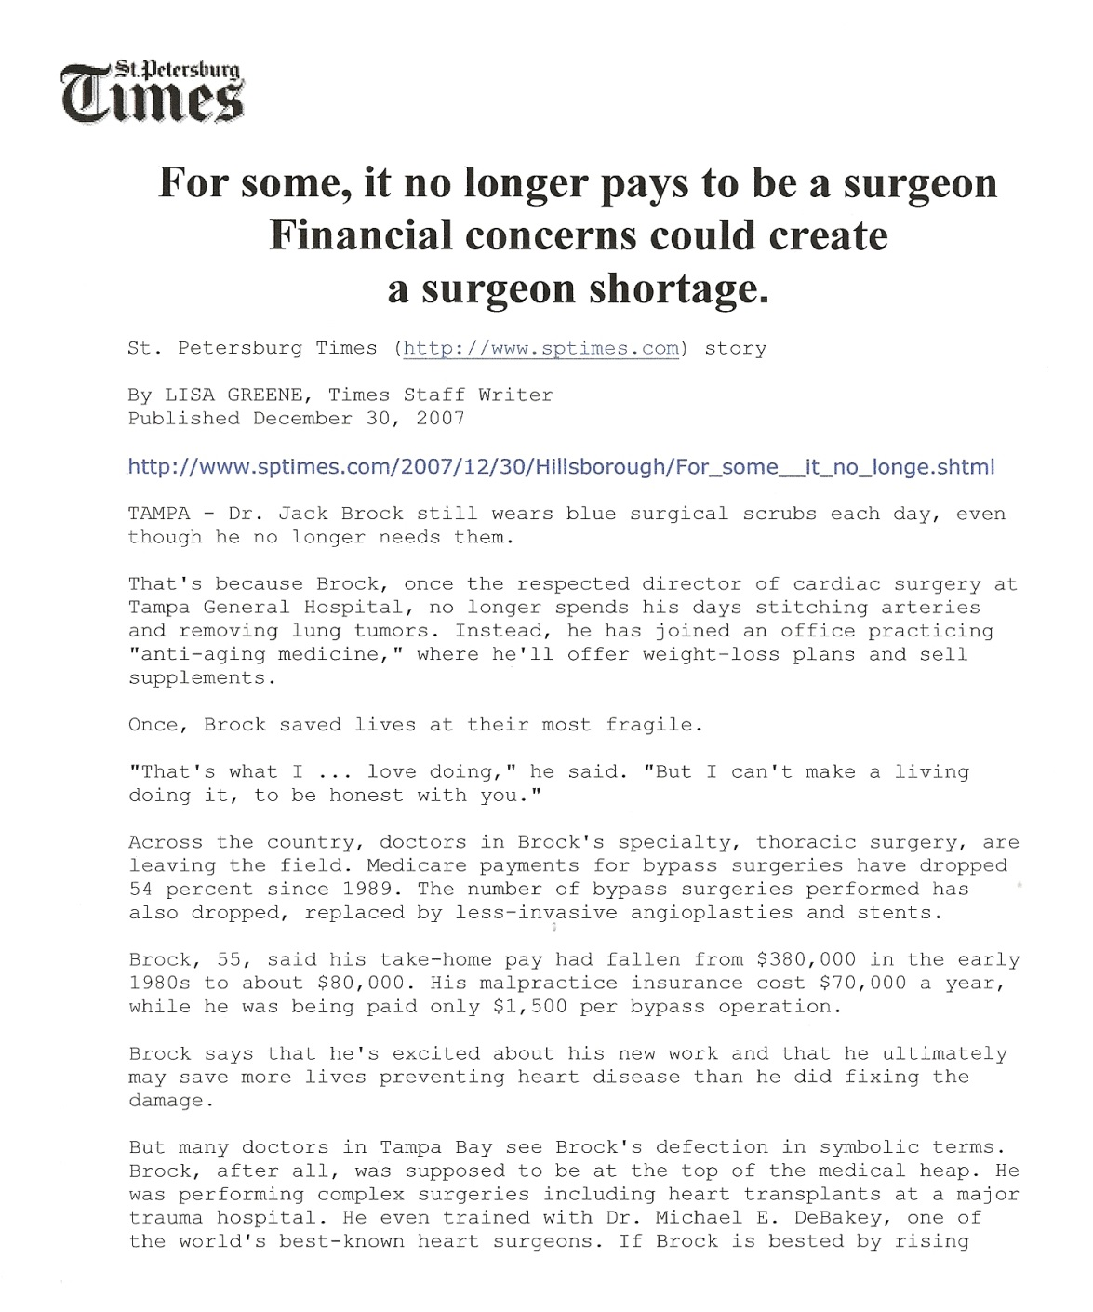
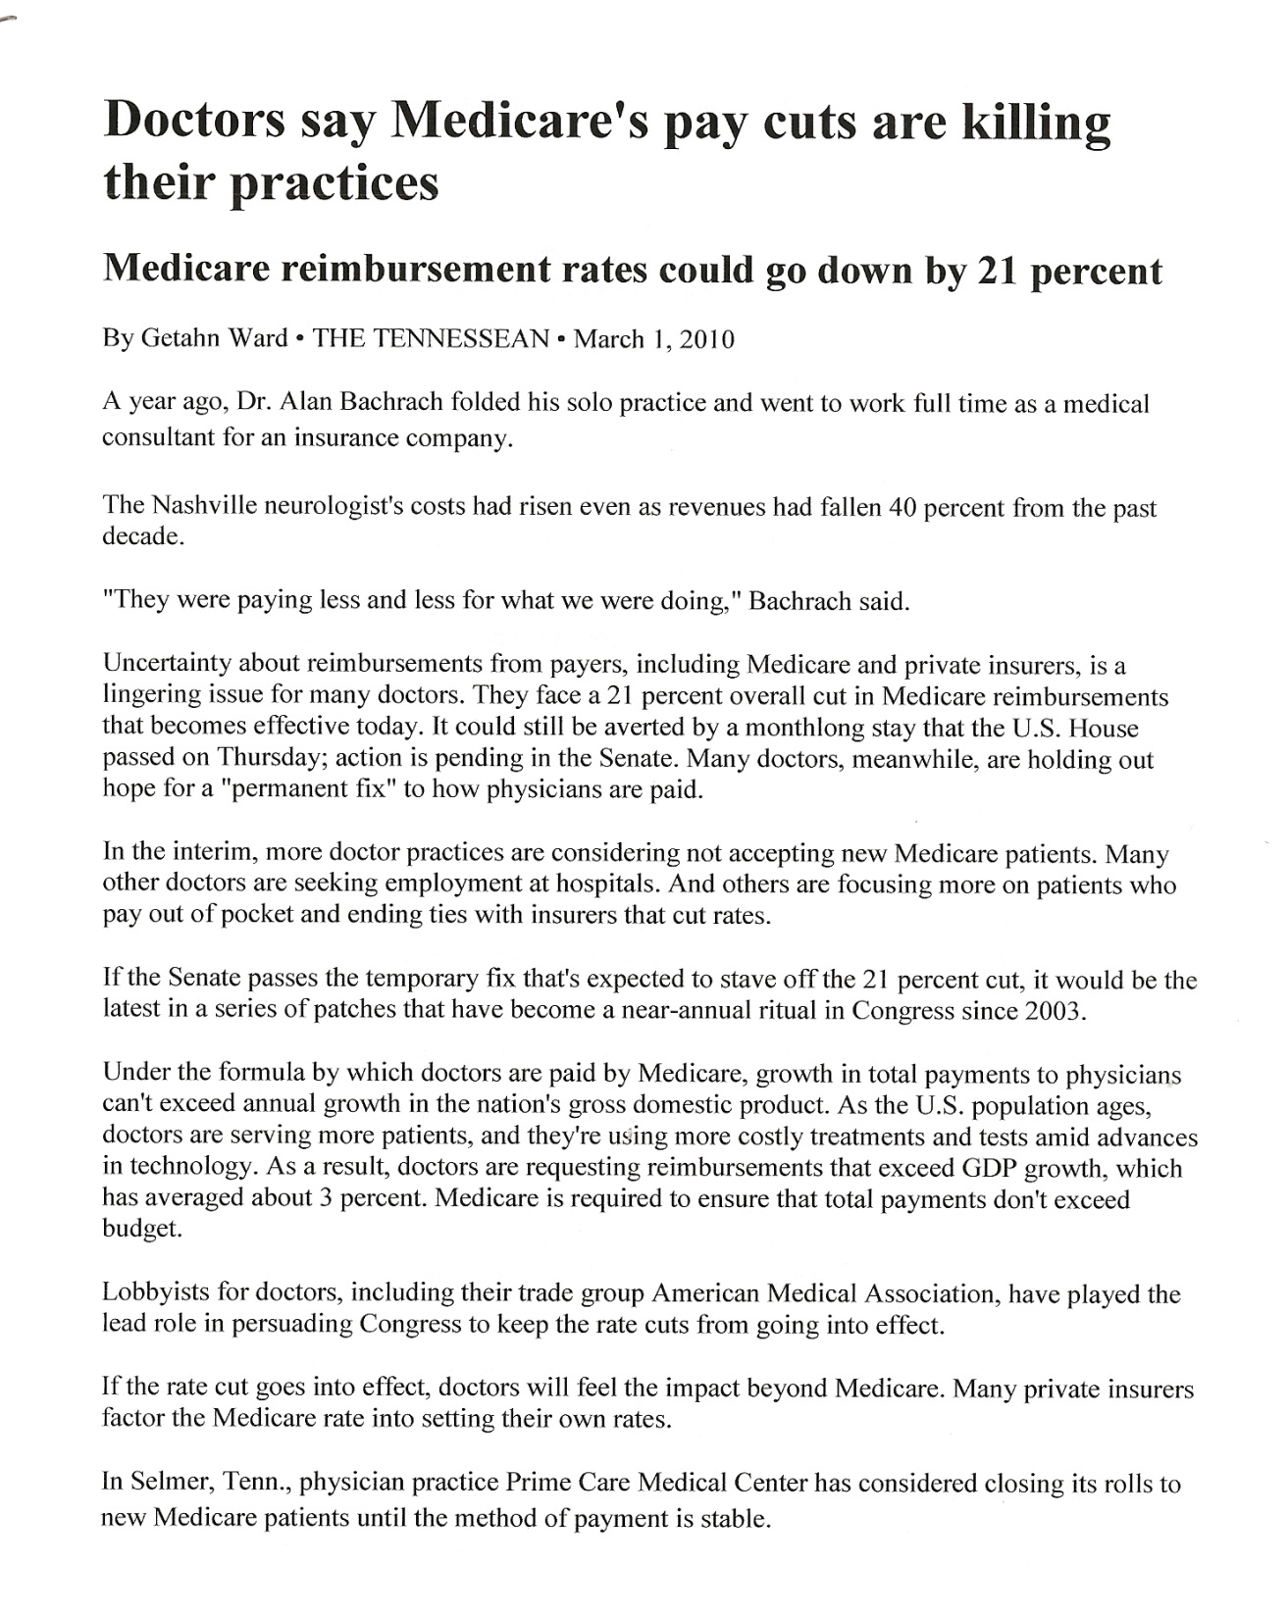
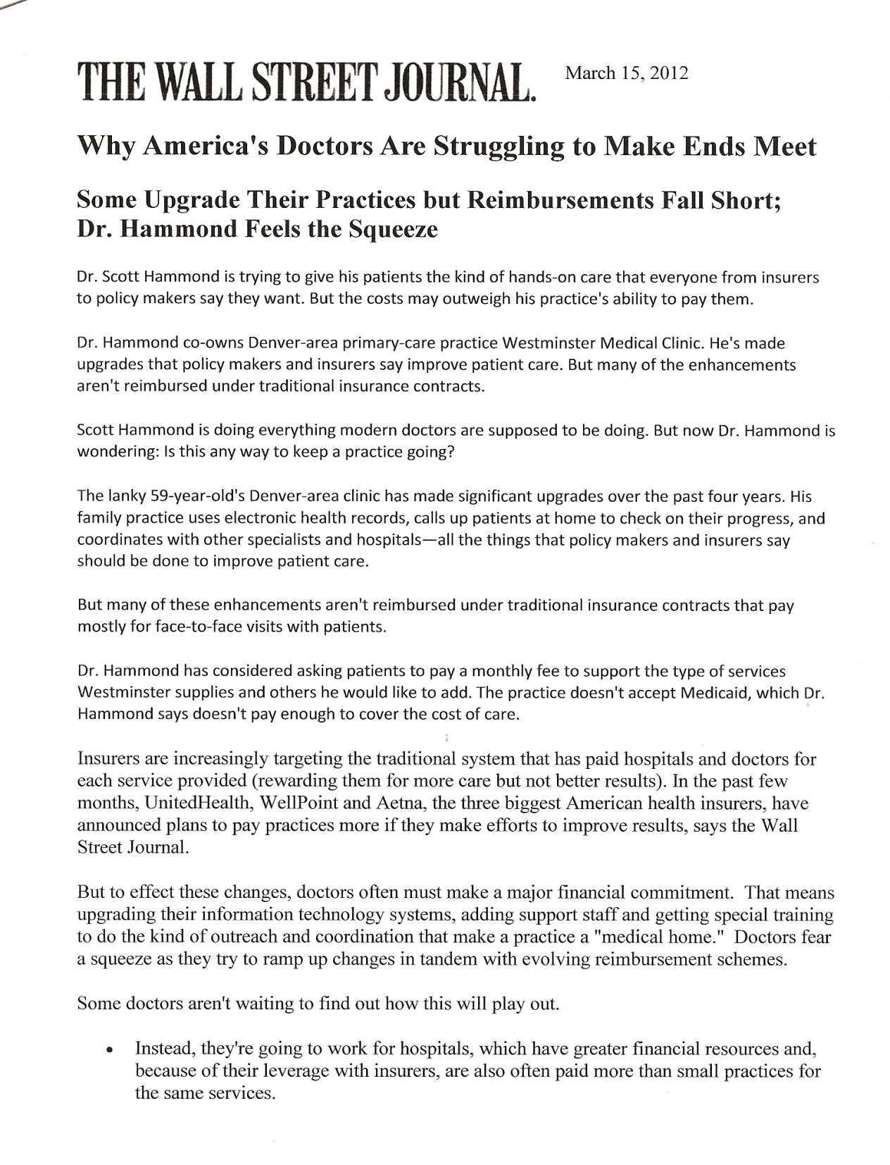
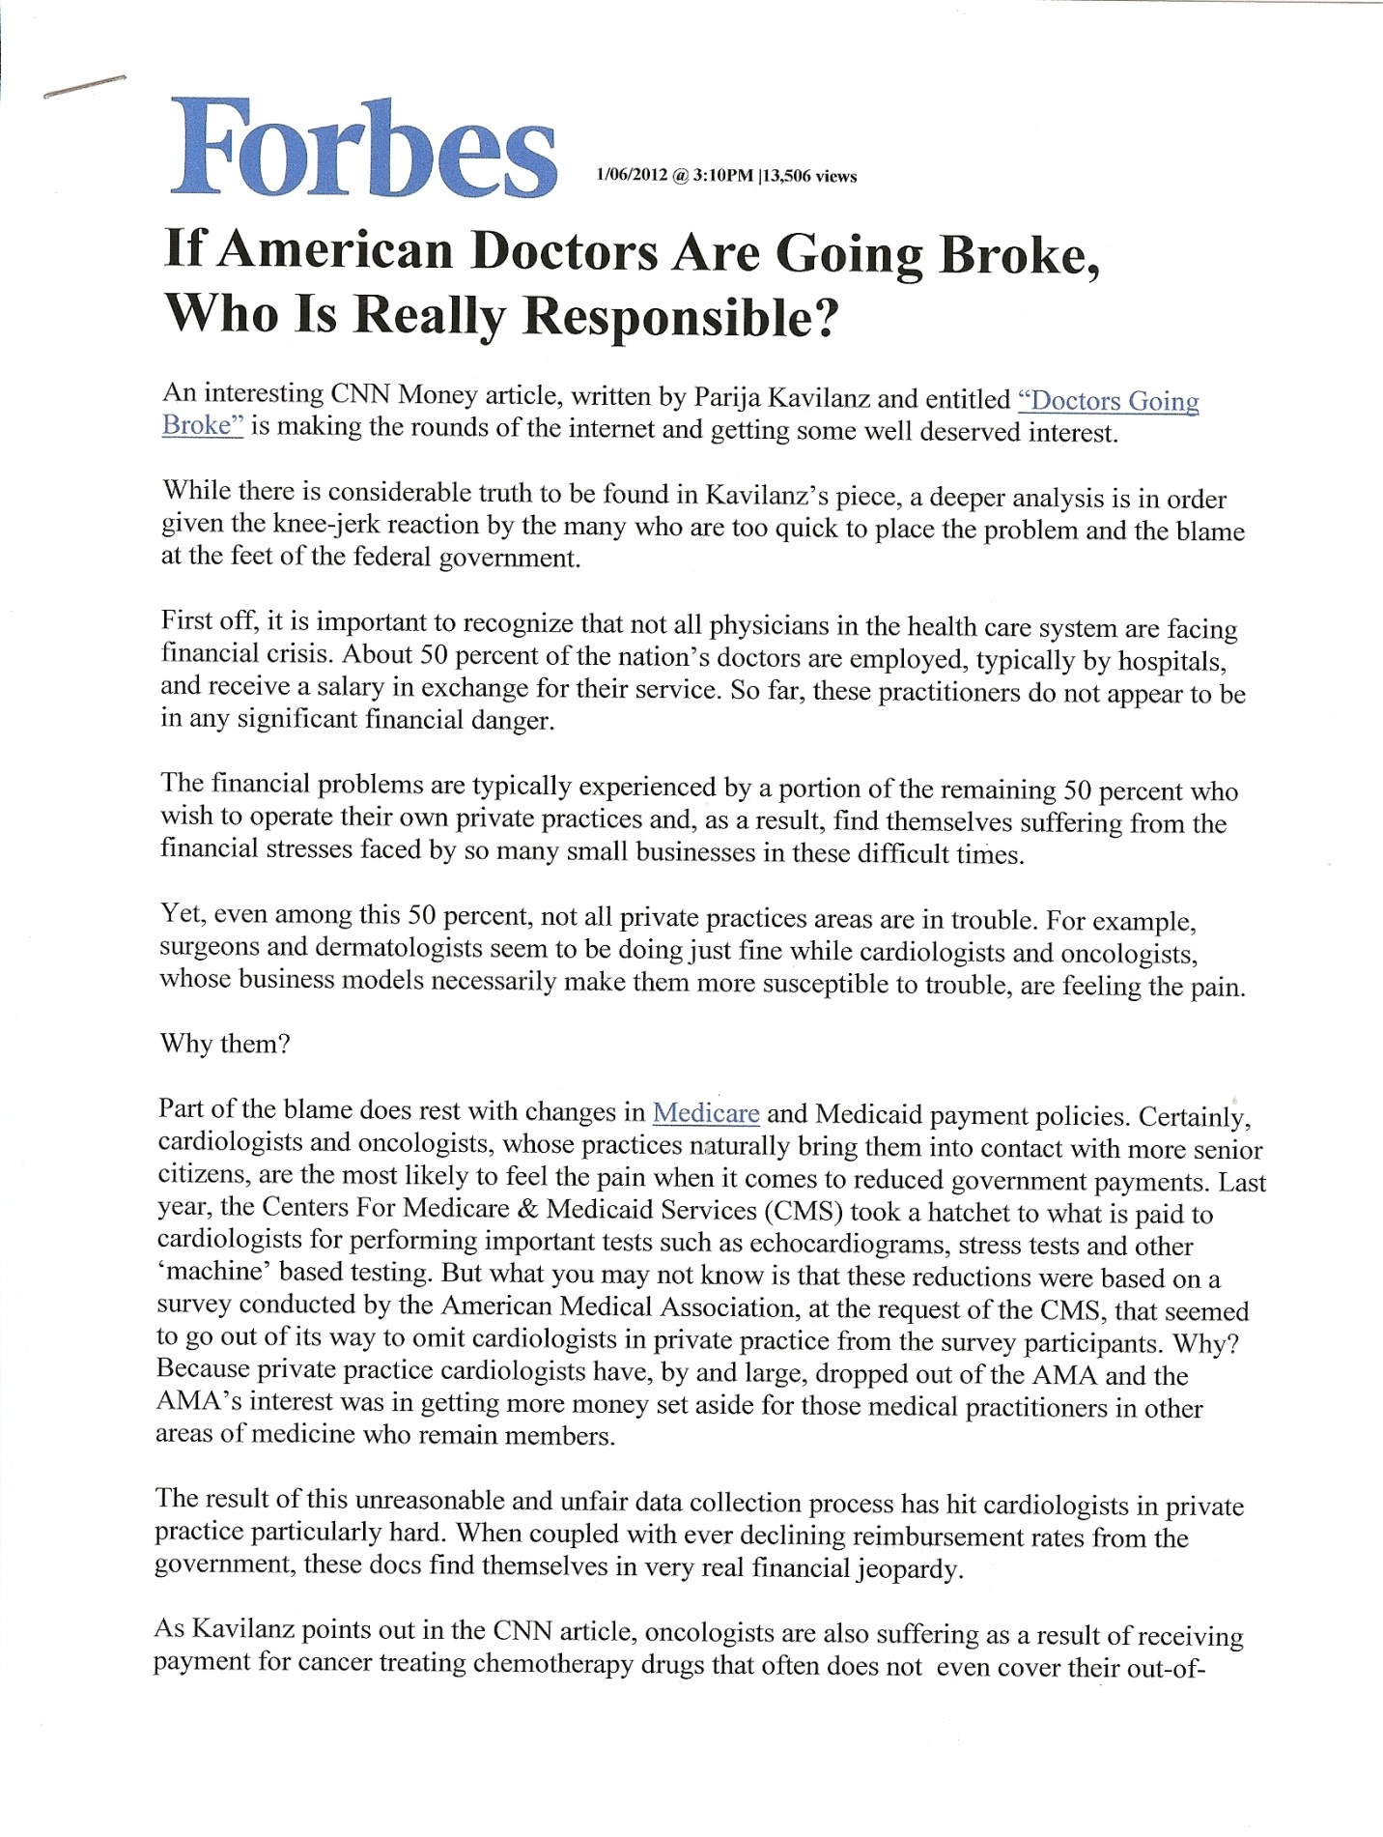

Slide 6
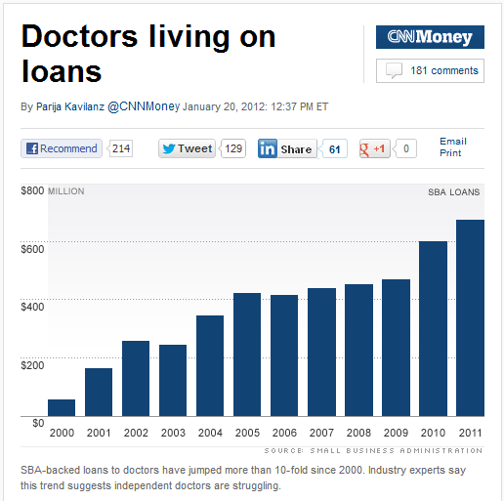
CNN Money, January 20, 2012
Economic changes have impacted the healthcare industry and Health Professionals are challenged with finding ways to adapt.
Source: http://money.cnn.com/2012/01/20/smallbusiness/doctor_loans/index.htm

Slide 7
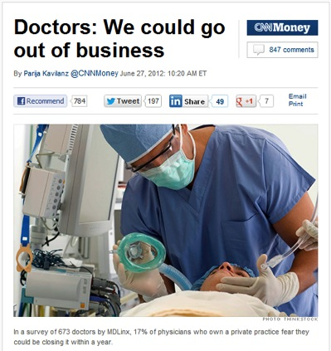
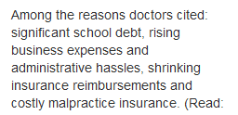
CNN Money, June 27, 2012
Cost of business increases while insurance reimbursements decrease.
Source: http://money.cnn.com/2012/06/27/smallbusiness/doctors-practices/index.htm

Slide 8
How Can Health Professionals Overcome Financial Pressure?
See more patients?
Work additional hours?
Open additional practice locations?
The above options require additional time and or overhead.
Have you considered offering additional services in your existing practice?

Slide 9
More Practices Now Offer Ancillary Services
23% of family physicians now provide ancillary services,
medication dispensing
weight-loss services
in-office diagnostic tests
nutrition counseling
cosmetic services
acupuncture and massage
It is estimated that some primary care practices may be able to earn as much as 15% or more from ancillary services
Source: http://www.medscape.com/features/slideshow/compensation/2014/public/overview#14

Slide 10
Are Patients Asking…
“What do you recommend to help me lose weight?”
“What multivitamin, calcium or omega -3 do you recommend?”
“What healthy alternatives do I have?”

Slide 13
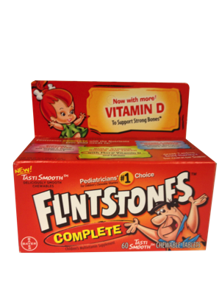
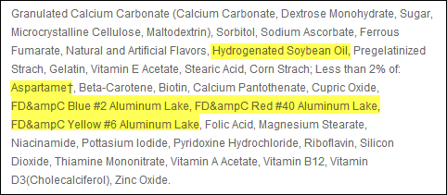
Popular Store Supplement Labels
Centrum® Women Under 50 is a product of Pfizer Consumer Healthcare. For more information, visit http://www.centrum.com/centrum-women-under-50#tablets
Flinstones™ Complete Chewables is a product of Bayer Healthcare. For more information, visit http://www.flintstonesvitamins.com/en/products/Flintstones_Complete.php/

Slide 14
nutraMetrix® Provides Solutions
nutraMetrix is in the right place at the right time.
nutraMetrix is helping Health Professionals generate additional revenue for their practices while providing the wellness-based products and services that patients are asking for.

Slide 15
The nutraMetrix® Mission
The mission of nutraMetrix is to provide a system for Health Professionals to create an ongoing income, while providing patients and clients with a better way to achieve optimal health.
Through revolutionary technology,
Science based nutritional interventions
and the power of people, nutraMetrix is changing the face of health care one health professional and one patient at a time.

Slide 16
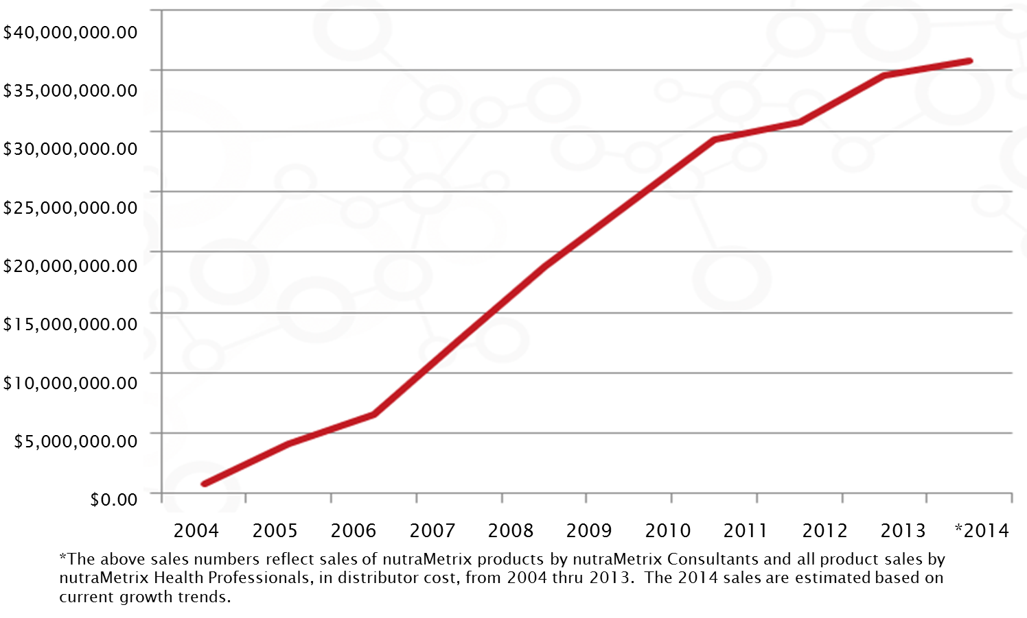
Our Success Reflects Your Success: Annual nutraMetrix® Sales

Slide 17
nutraMetrix®: Commitment to Quality
nutraMetrix products lead the industry thanks to cutting-edge ingredients, sound science and exceptional quality control.
The Product Brokerage Advantage of nutraMetrix:
Identifies the latest market-driven products from the best manufacturers.
Provides comprehensive and synergistic formulations based on current research.
Offers a wide variety of products formulated by experts in the industry.

Slide 18
nutraMetrix®: Commitment to Quality
Every product is manufactured with strict quality control guidelines and continuous quality control monitoring.
Specifications are set for raw materials and finished products.
Raw materials are sourced with Certificates of Analysis.
Products are manufactured using Standard Operating Procedures in manufacturing facilities that are audited on a regular basis for GMP compliance.
Products are inspected at our warehouse for damage, label accuracy, appearance, taste and odor prior to release.
Products are assayed by independent labs for isotonic capability, micro contamination and potency.

Slide 19
The nutraMetrix® Difference
Isotonic-capable nutrition
Customizable products
Gene SNP™ DNA Analysis
TLS® Weight Loss Solution
NC support
Setting you apart from other practices of the same specialty.

Slide 20
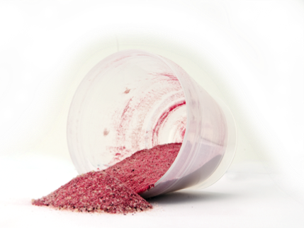
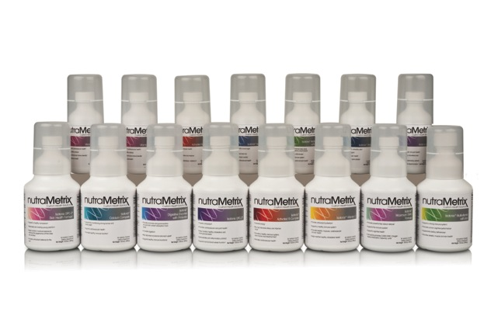
Isotonic-Capable Nutrition
Superior nutrient delivery
Exceptional quality control measures
Quality sourcing of ingredients
Comprehensive and synergistic formulations
HP Value:
Better delivery
Better compliance
Better results
Patient Value:
Easy to take
Great taste
Results they can feel

Slide 21
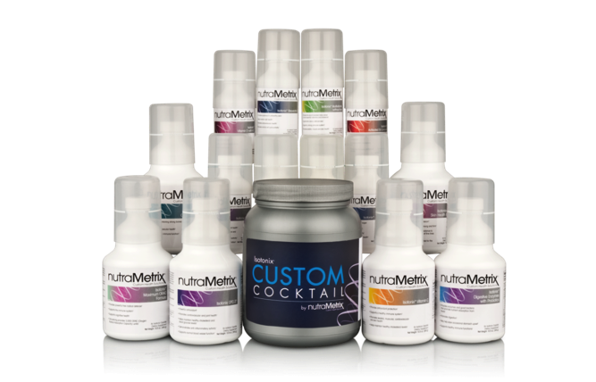
Customizable Products
Ability to design customized isotonic-capable formulas.
HP Value:
Customize unique formulas for your practice or for each patient
Reliable patient results
Better patient compliance
Patient Value:
One-stop convenience
Simplified, customized nutritional support
AutoShip for easy refills

Slide 22
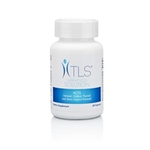
TLS® Weight Loss Solution
The TLS Difference:
A science-based weight management program
Weight loss supplements that maximize results
Online support tools
HP Value:
Addresses an immediate need of your patients and bottom line
Provides solutions for obesity-related health challenges
Patient Value:
A weight loss system that provides Effective and long-term results

Slide 23
nutraMetrix® Consultant Support
Your nutraMetrix Consultant is your partner in implementation.
Practice assessment and proposals
Customized implementation plans
Staff training and education
Ongoing support and monitoring
HP Value:
Personalized consultant that has your best interest in mind
Patient Value:
Convenient solutions for optimal wellness from a trusted source — their own Health Professional

Slide 27
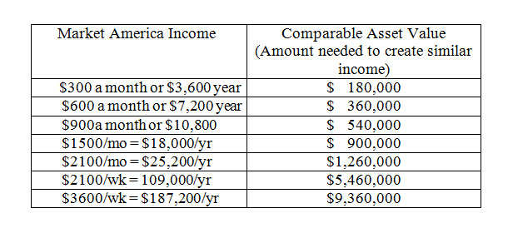
What is Residual Income?
Financial Advisors use the 10 Year U.S. Treasury Bond as a benchmark to calculate how much money you would need to invest to receive a certain amount of income.
As an example: To create an ongoing residual income of $100,000 per year, you would need to have $5,500,000 invested in a 10 year U.S. Treasury Security, presently paying 2%.
The following schedule highlights the amount of money you would need to have invested to create the income stream provided by Market America Performance Compensation Plan.

Slide 28
THANK YOU
Next steps:
Get your questions answered.
Try some product.
Have your nutraMetrix® Consultant customize a wellness plan to suit your unique office needs.
Evaluate to see if nutraMetrix is a fit for you.
Thank you for learning about nutraMetrix Custom Health Solutions.

Slide 29
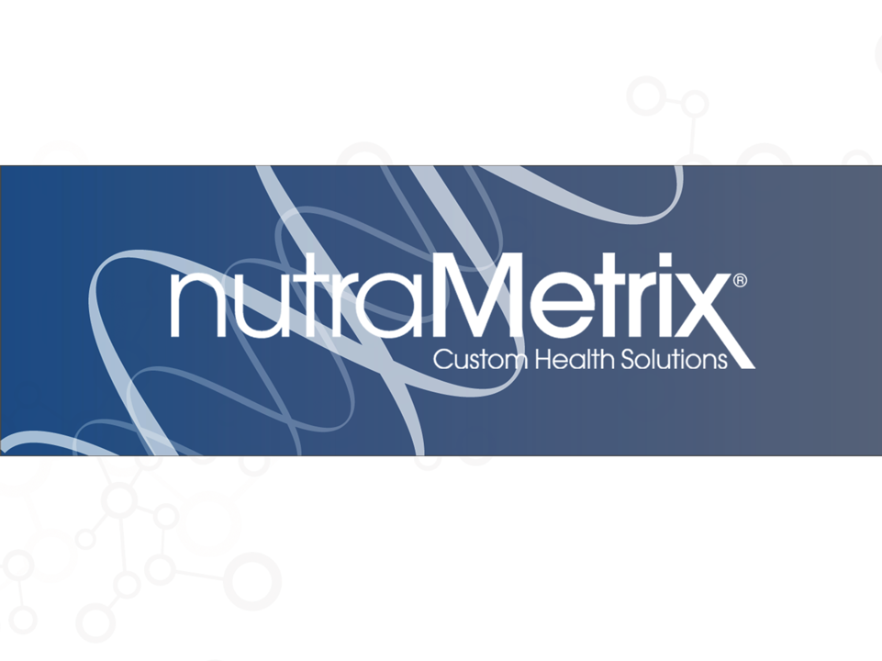
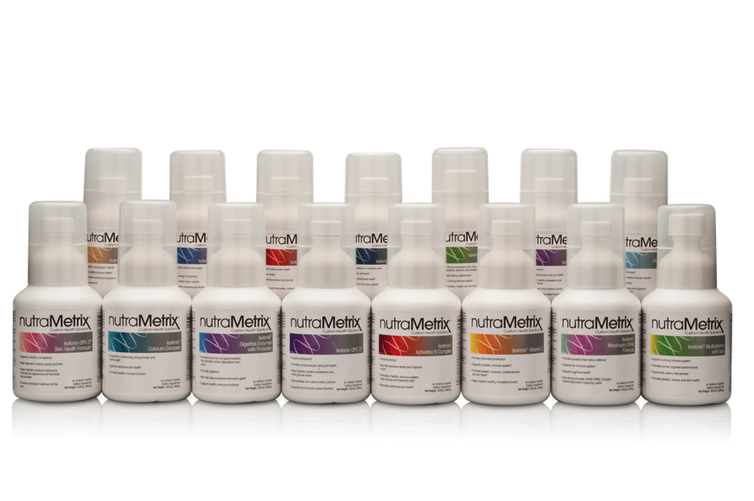
Delivering Wellness for Your Patients and Practice

